Slide 1

Ge Bian
Unique Name: biange

Slide 2
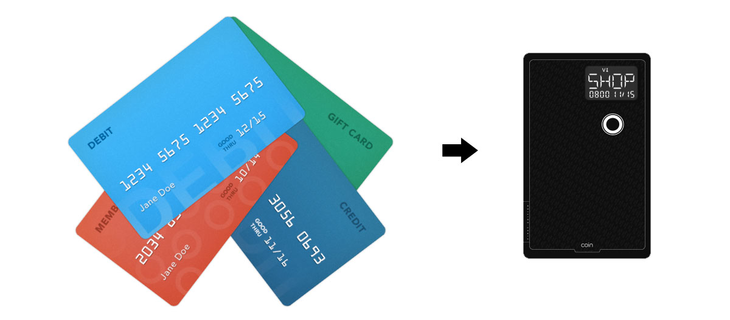
Product
All in One Credit Card
A universal credit card shaped device that can be used everywhere payment cards are accepted.

Slide 3
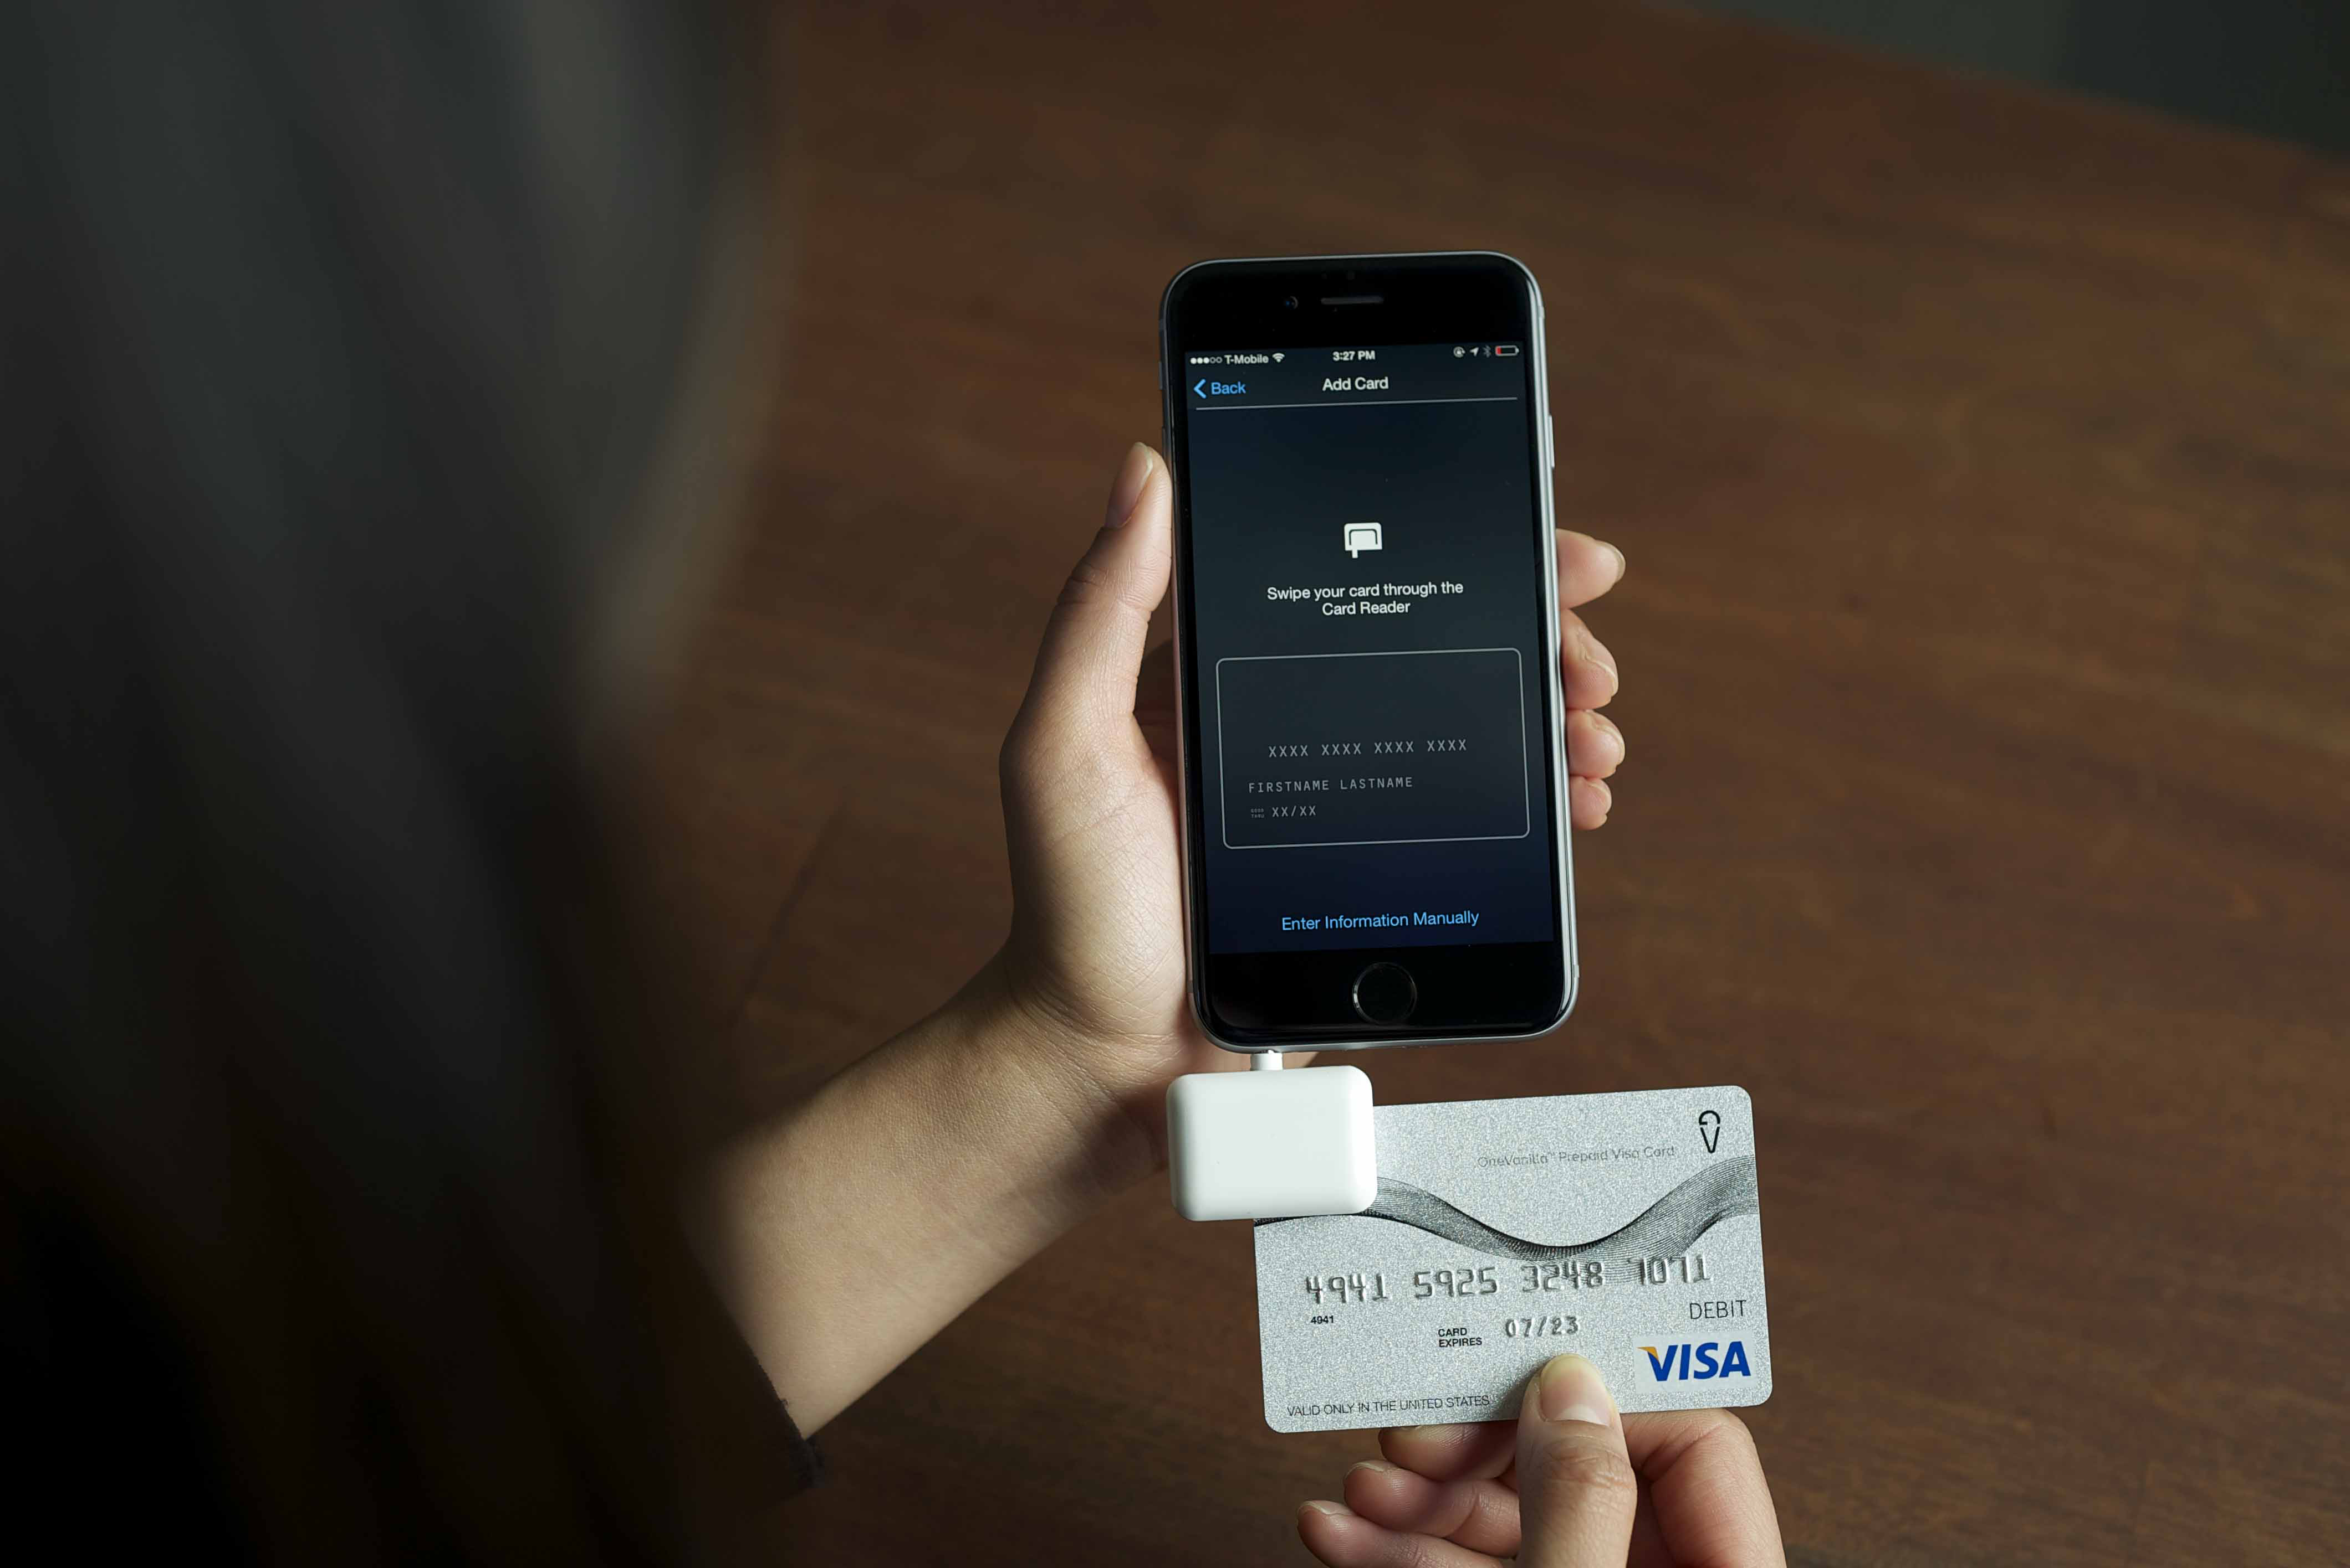
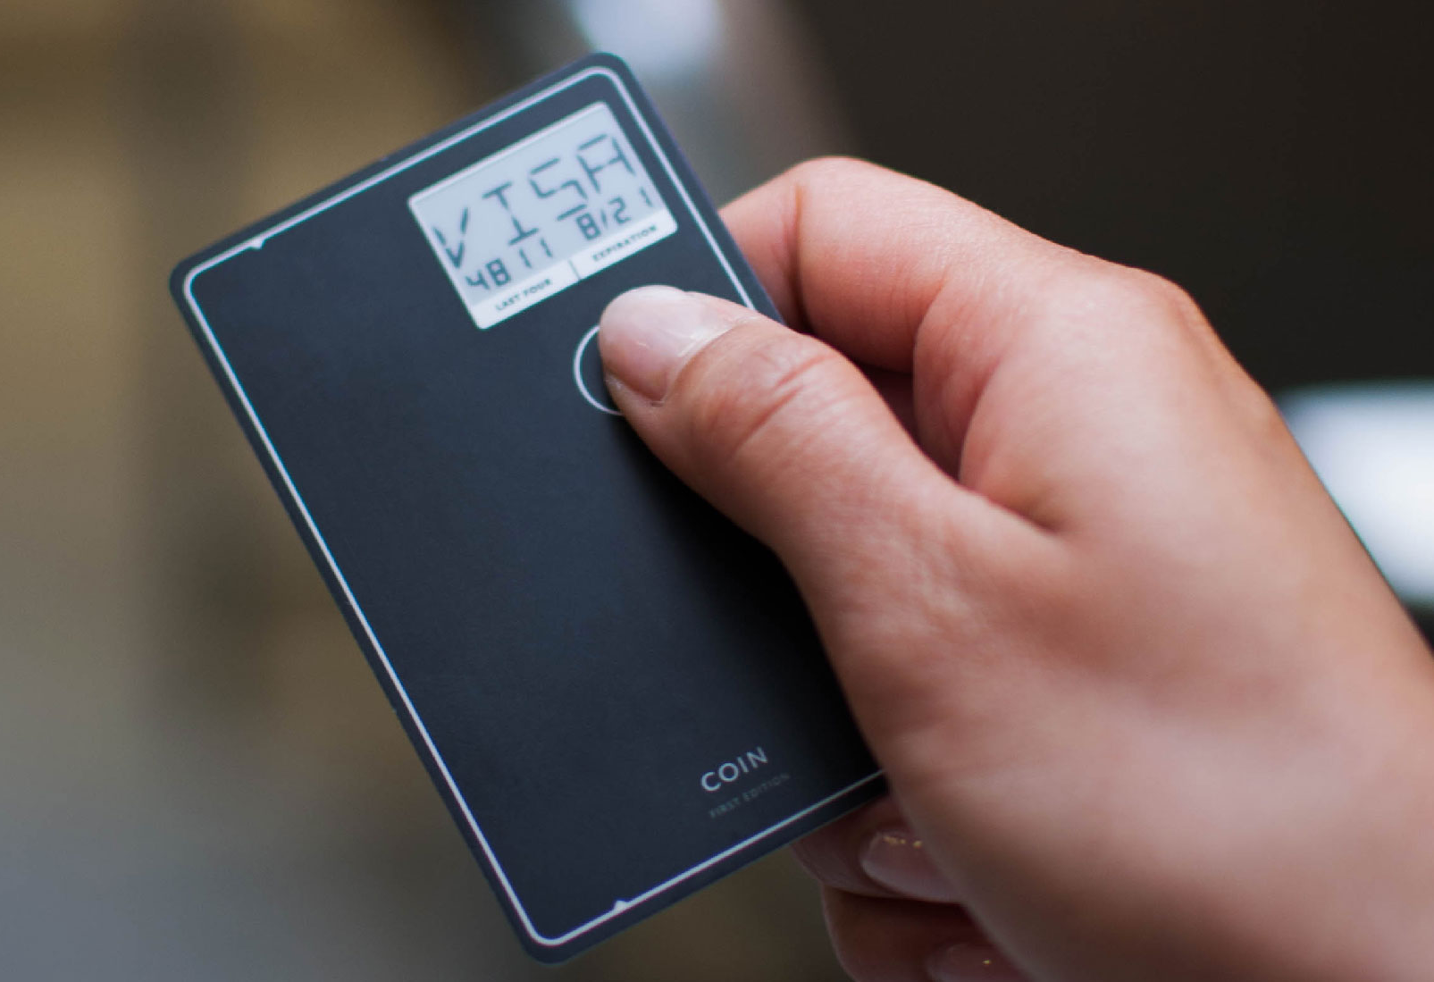
Product
Notes:
Once the app is set up, users can pair their Coin and add new cards by manually entering information, swiping the card through an included card reader that goes into the headphone jack of the phone, or by taking a picture of the card as you would with Apple Pay.

Slide 4
Finance
Based on crowd-funding
Raised $50,000 in 40 minutes on their website
350,000 pre-orders in first two month

Slide 5
History
Founded by Kanishk Parashar in 2012
First debuted (pre-order) in Nov. 2013
Started shipping in Nov. 2014 (Coin)
Regular orders started in Apr. 2015 (Coin 2.0)
Since shipping in April, Coin has been swiped more than one million times

Slide 6
Story
Delay Shipment
Originally slated to ship in summer of 2014
Regular orders started in Apr. 2015
Surprised by 350,000 pre-orders
Transition: POS -> EMC

Slide 7
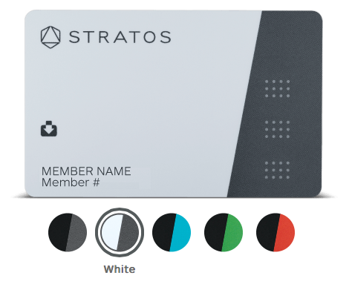



Competition
Notes:
Stratos: said to be shipped in 2015 summer, $155

Slide 8
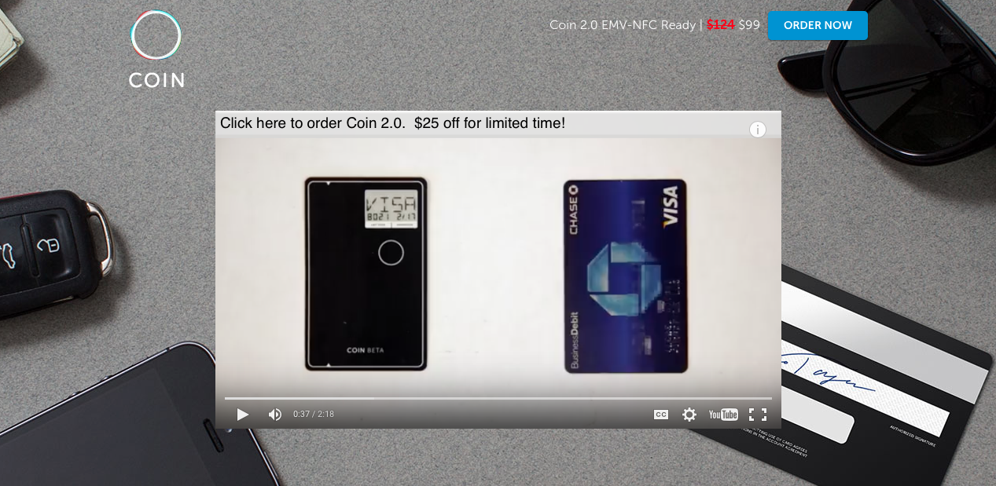
Prediction
Succeed in short run
Pricing
Expand business
Notes:
The first backers will get the device for $50, though it will retail for $100. However, $25, $99, $124 too much

